Slide 1
Inflation in an Island of High Prices. The Factors behind Price Stability in Switzerland
Celâl Güney, Michalis Nikiforos, Guillaume Dreyer

Slide 2
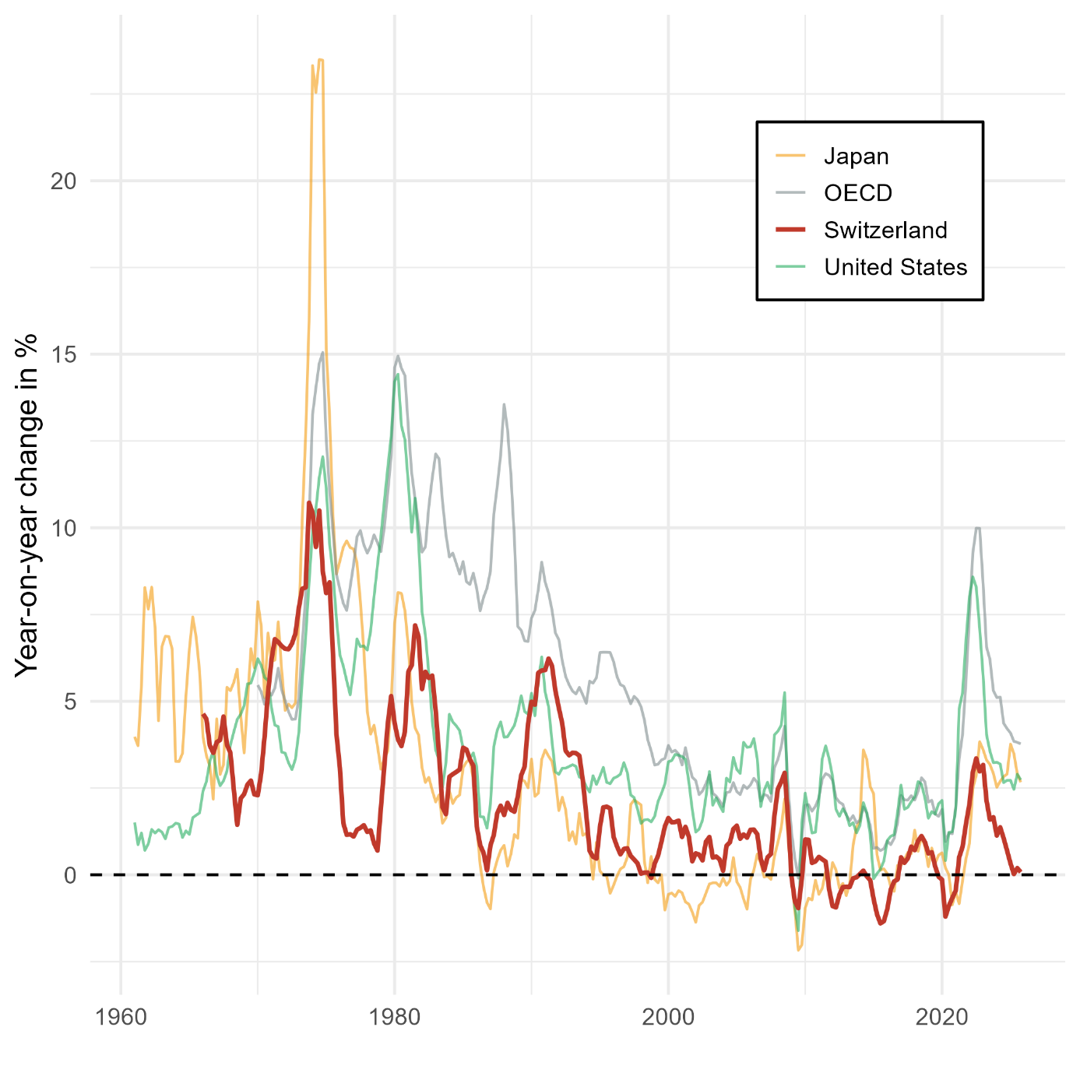
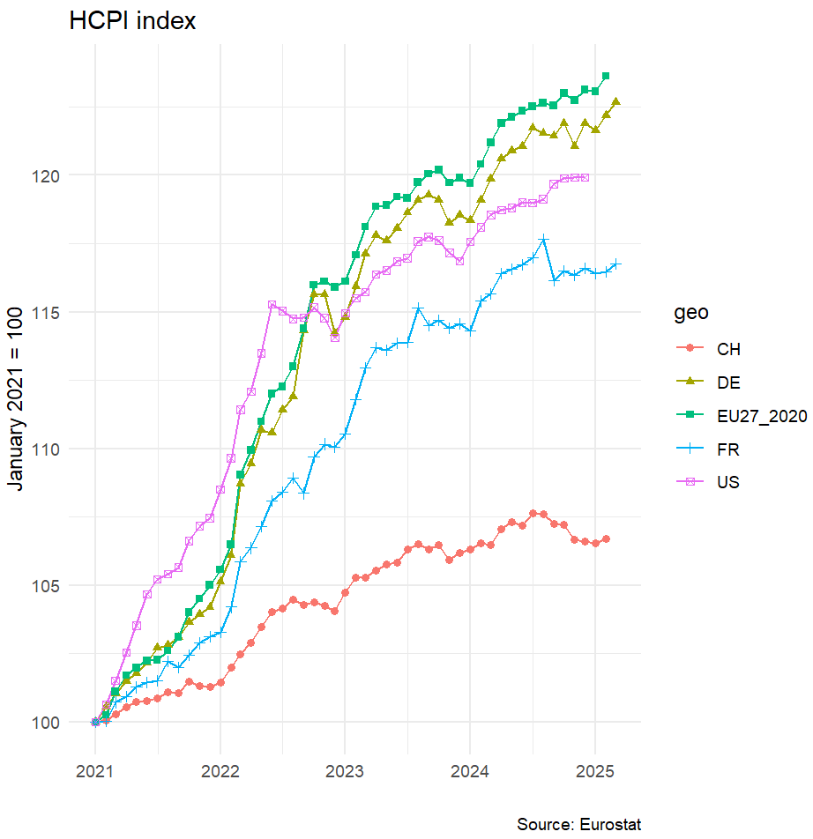
Research Question: why does Switzerland have lower inflation rates ?
National CPI indices, source: OECD

Slide 3
Structure of the paper
Introduction
  Main stylized facts on Swiss prices: low inflation combined with a very high price level
Literature review of three types of explanation:
  (1) The strength of the Swiss franc due to its safe haven status
  (2) The construction of the Swiss consumer price index
  (3) The role of price administration
The role of price administration in systemically significant sectors
The energy sector
The socio-political coalition behind the island of high prices

Slide 4
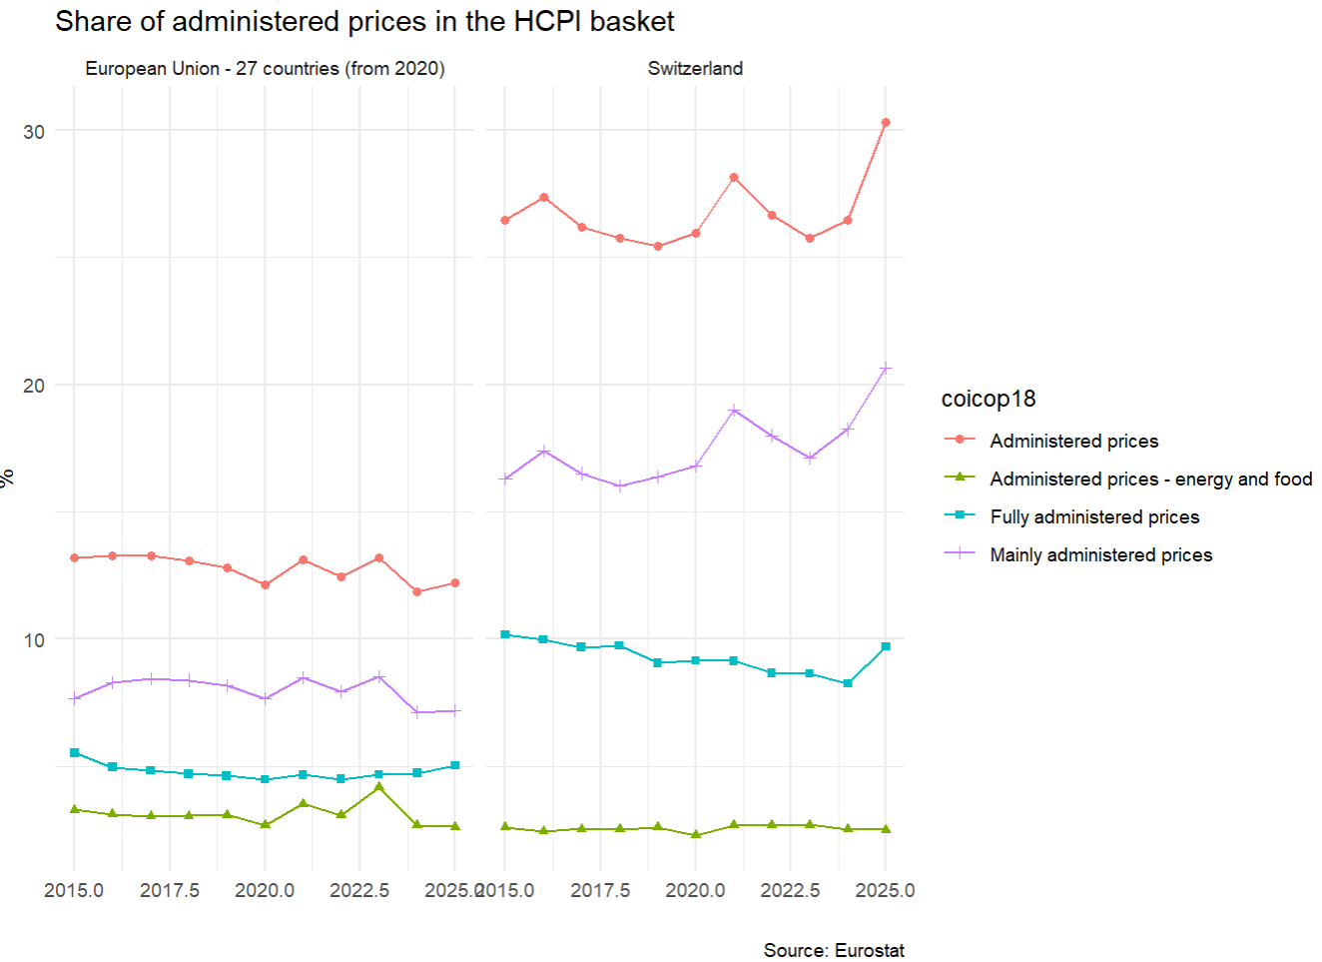
The role of price administration
Switzerland has the highest share of administered prices in its HCPI compared to other European countries (around 30%)
Prices are for example administered for energy (mainly electricity), district heating, food products, public transports…

Slide 5
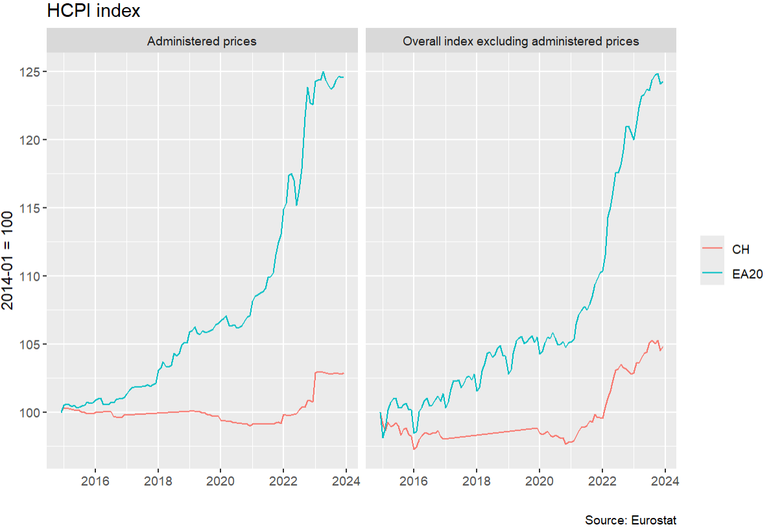
Arguments against an effect of price administration on low inflation in Switzerland
Auer el al. (2025): aministered prices in Switzerland increased less than in the EU, but this is also the case for non- administered prices (figure on the right)

Slide 6
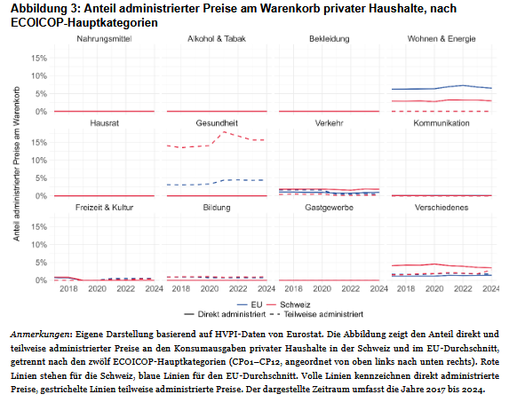
The high share of administered prices in Swiss HCPI: an institutional artefact ?
Among the 30% share of administered prices (APs) in the Swiss HCPI, around 15% are health products and services
This high share of APs, rather than an active policy of price control, rather reflects the peculiar Swiss mandatory health insurance system ➔ Swiss healthcare costs are not covered until a franchise (minimum 300 francs) is reached
Lukas Mergele et al., « Administriete Preise », Grundlagen für die Wirtschaftspolitik (Bern), nᵒ 62 (2026).

Slide 7
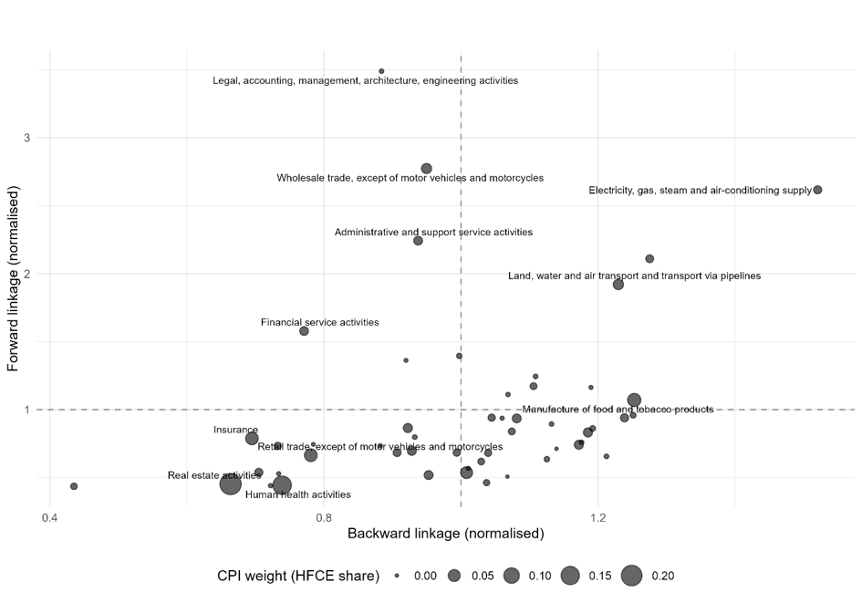
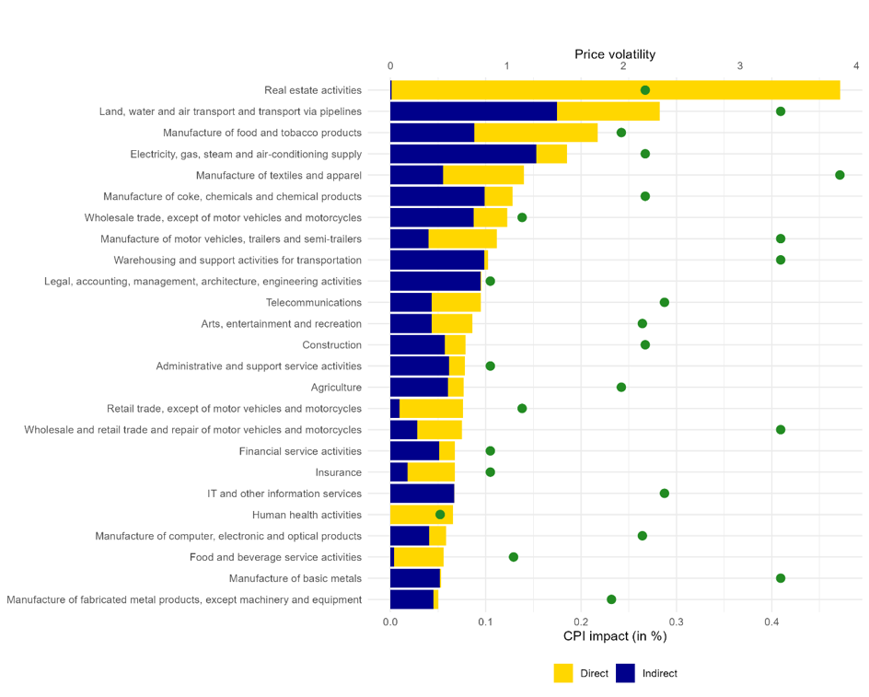
Our approach: the role of price administration in systemically significant sectors
Results from a Leontief price model on Swiss input output table (2017)

Slide 8
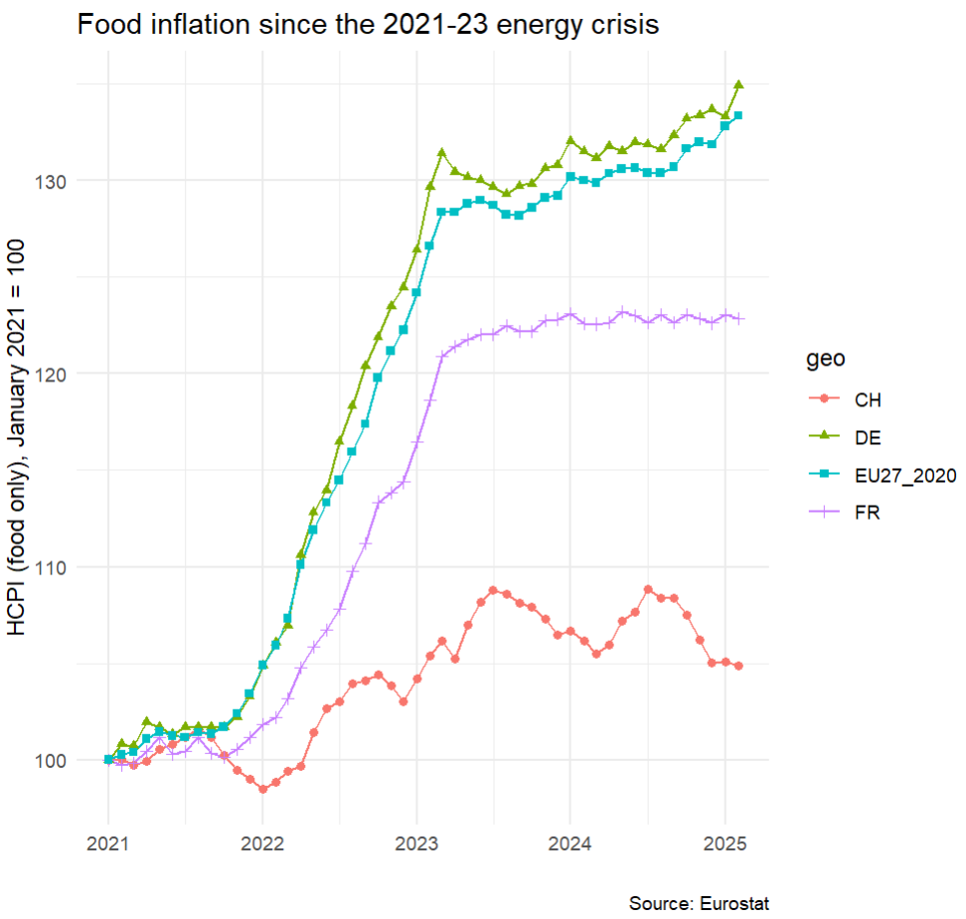
Example: Food production, transformation and retail ➔ interactions between regulations and duopolistic power
Swiss food prices are particularily resistant to international shocks
This is mainly due to the fact that food prices are largely sheltered from international fluctuations through indirect price control
  Protection of the agricultural sector through import tariff rates quotas and subsidies
Food transformation and retail are furthermore controlled by two large cooperatives (Coop & Migros), whose power come from the tradition of protection of the Swiss domestic sector by the state

Slide 9
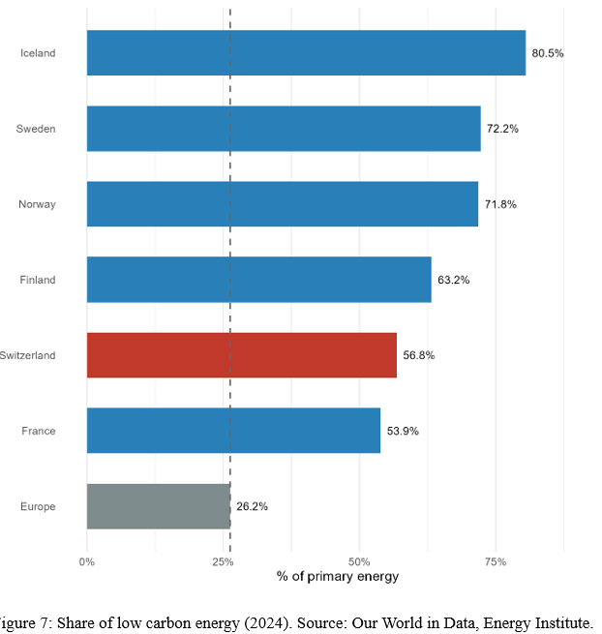
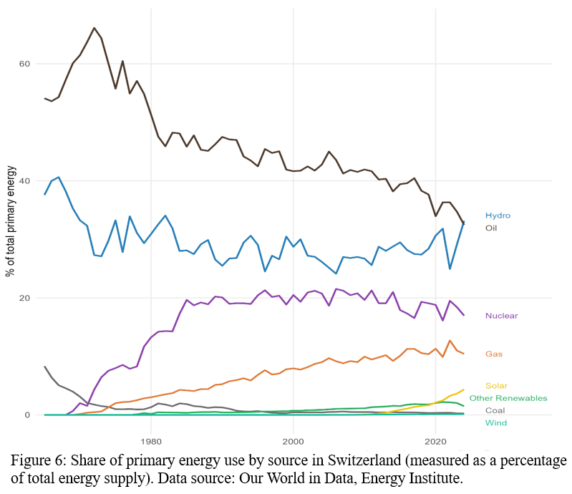
Example 2: energy and electricity
Switzerland resistance to international energy shocks also come from the combination and complementarity between a well-diversified energy mix, low energy intensity and the fact that electricity supply is not governed by a liberalized market as in the rest of Europe

Slide 10
The socio-political coalition behind price stability
Price administration, imports control and the protection of the domestic sectors are often pointed out in Switzerland as responsible for the country's price stability, but at the expense of a very high price level.
In the Swiss political economy literature, these regulations are analyzed as the result of a compromise within a "bourgeois bloc" composed by the governing right-wing political parties and the business interests associations (BIAs) of the export-oriented and domestic-oriented industries.
The compromise is based on the principle of "external liberalization with domestic compensation"

Slide 11
The bourgeois bloc narrative on the Swiss high price island
Price stability at the expense of a high price level comes from the domestic compensation measures implemented by the bourgeois bloc to draw the support from domestic-oriented industries which are less competitive than the firms oriented towards international markets
However, does the Swiss high price level really come from these regulations ? Sax and Weder (2009) for instance argued that other factors such as the improvement in the Swiss terms of trade (ie the success of its exports) are a better explanation

Slide 12
Conclusion
Price administration does play a role for price stability due to their prevalence in sectors with systemically significant prices
However, other factors such as Switzerland's low energy intensity, which has improved in the last decades due to favorable structural change, also plays an important role.
Further enhancements of the paper
  More research is needed on the origins of Switzerland's high price level, beyond the dominant explanation based on the high degree of regulation of the domestic sector
  Domestic output and imports tables from the OECD simulate shocks more relevant to the research question, especially Switzerland's resistance to international price shocks

